Slide 1
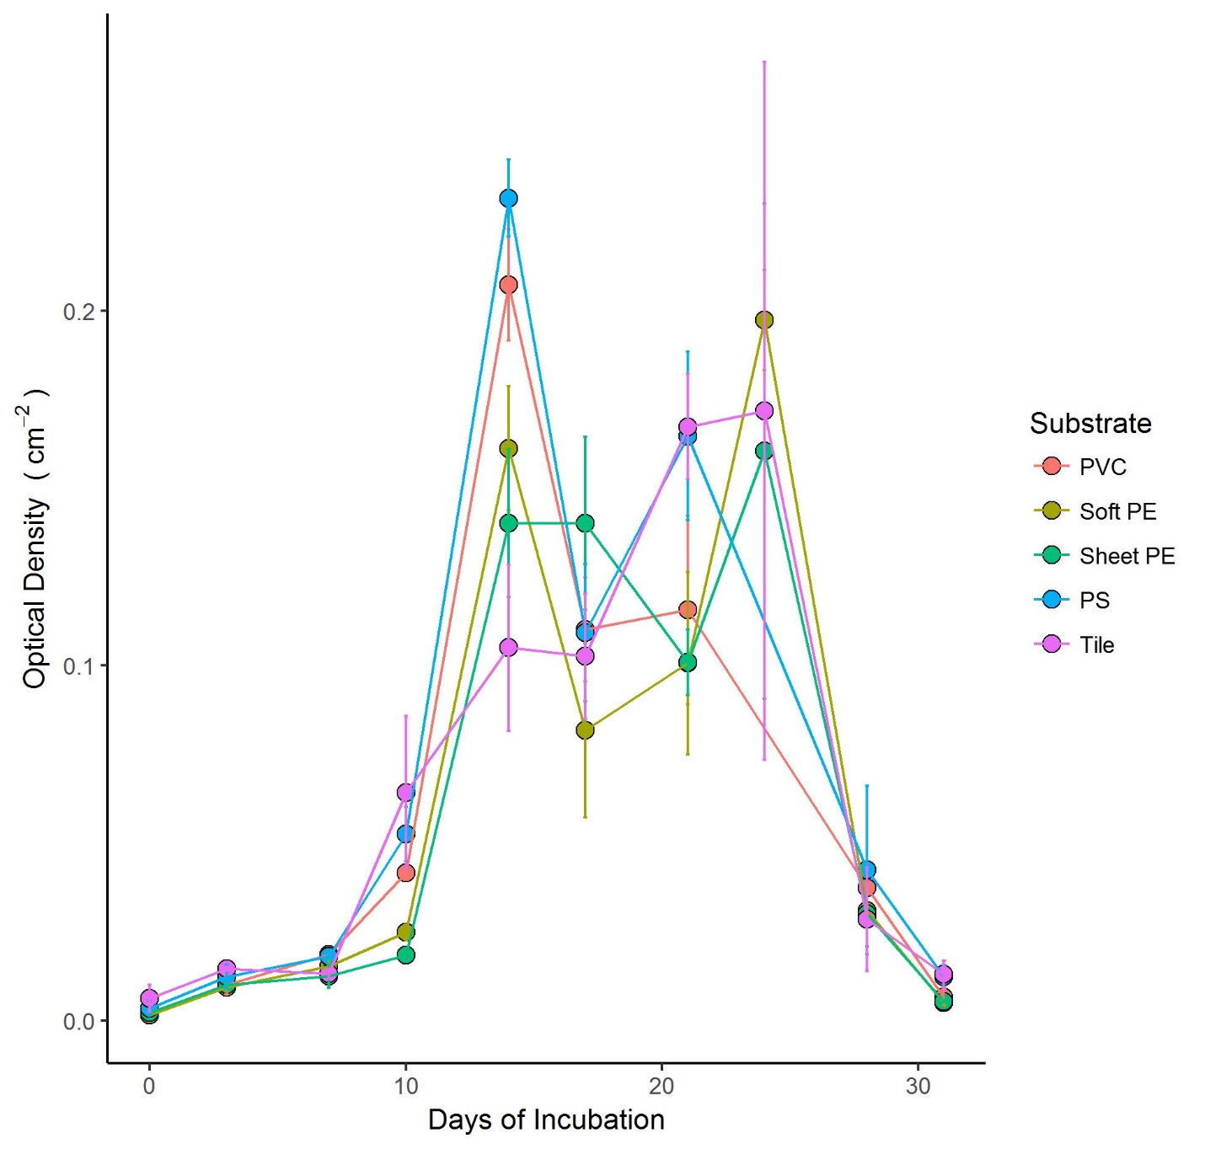
b
bc
c
a
a

